Slide 1
Sprocket Central Pty Ltd
-The Analytics Team
Data Insights :

Slide 2
Contents
. Introduction
. Data Exploration
. Model Development
. Interpretation

Slide 3
Introduction
. The supplied data would reveal useful customer insights which could help optimise resources allocation For targeted marketing. Hence, improve performance by focusing on high value customer
. The business could be boosted by analysing their existing customer dataset to determine customer trends and behaviour.
. Here The Customer Analysis will include understanding the data distributions, feature engineering, data transformations, modelling, results interpretation and reporting.
.

Slide 4
Customer Analysis
. Profit distribution w.r.t each Customer
. Past 3 years Bike sale w.r.t each Customer
. Brand wise analysis Customer’s Job Industry
. Profit distribution w.r.t Customer’s Age

Slide 5
Data Exploration
Data exploration refers to the initial step in data analysis in which data analysts use data visualization and statistical techniques to describe dataset characterizations, such as size, quantity, and accuracy, in order to better understand the nature of the data.

Slide 6
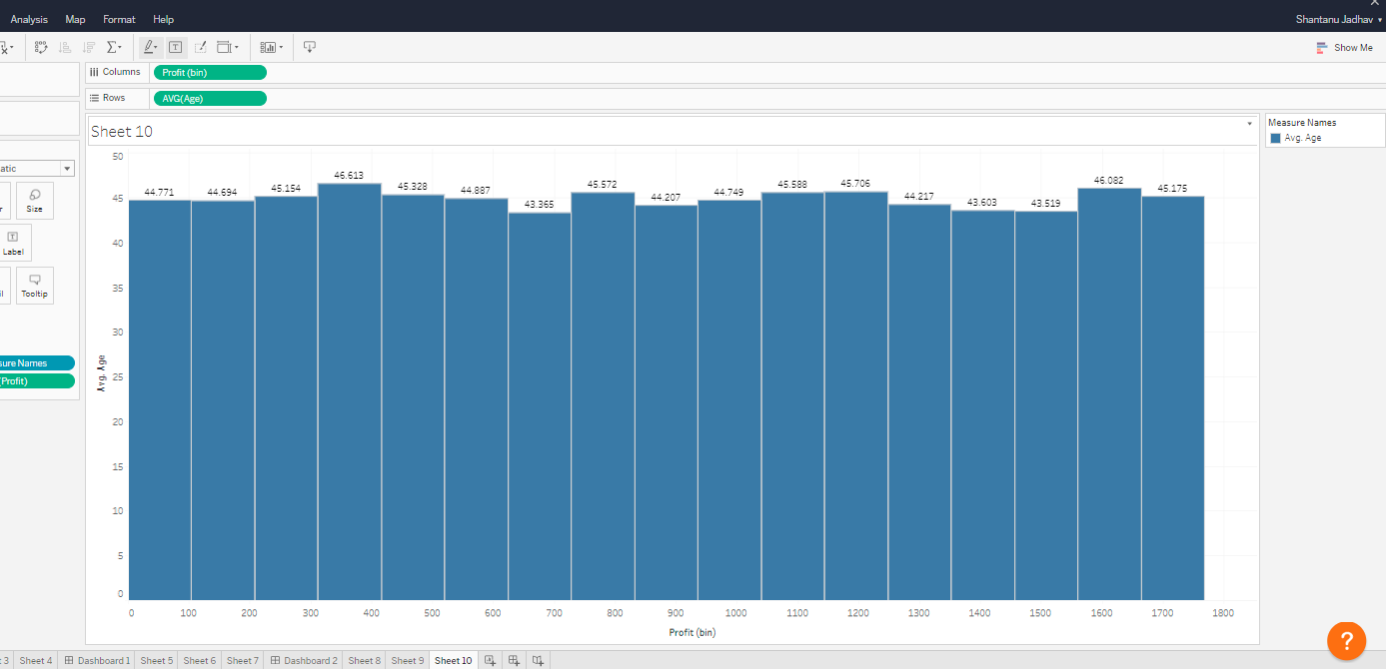
Data Exploration :
Profit w.r.t Customer’s Age

Slide 7
Model Development
Model Development is the process of using business logic to aggregate over event level data to produce ‘modeled’ data that is simpler for querying.

Slide 8
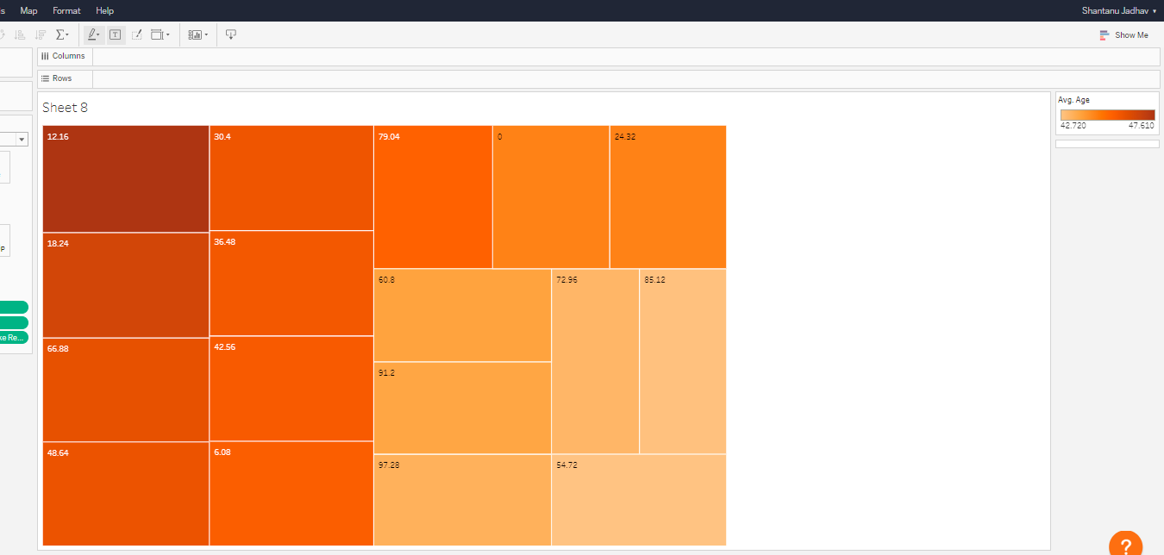
Model Development :
Past 3 years bike sale w.r.t Customer’s Age

Slide 9
Data Interpretation
Data interpretation is the process of reviewing data through some predefined processes which will help assign some meaning to the data and arrive at a relevant conclusion. It involves taking the result of data analysis, making inferences on the relations studied, and using them to conclude.

Slide 10
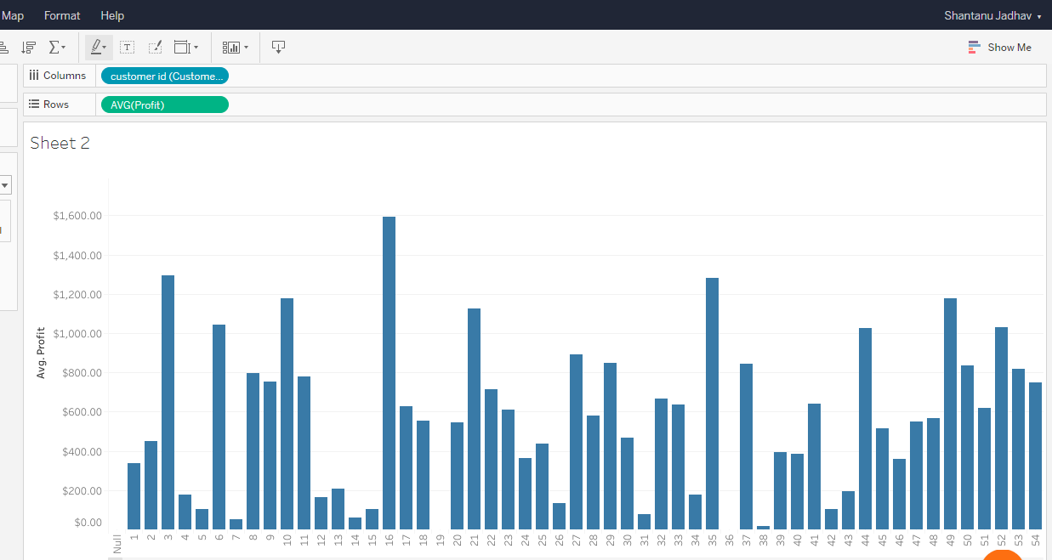
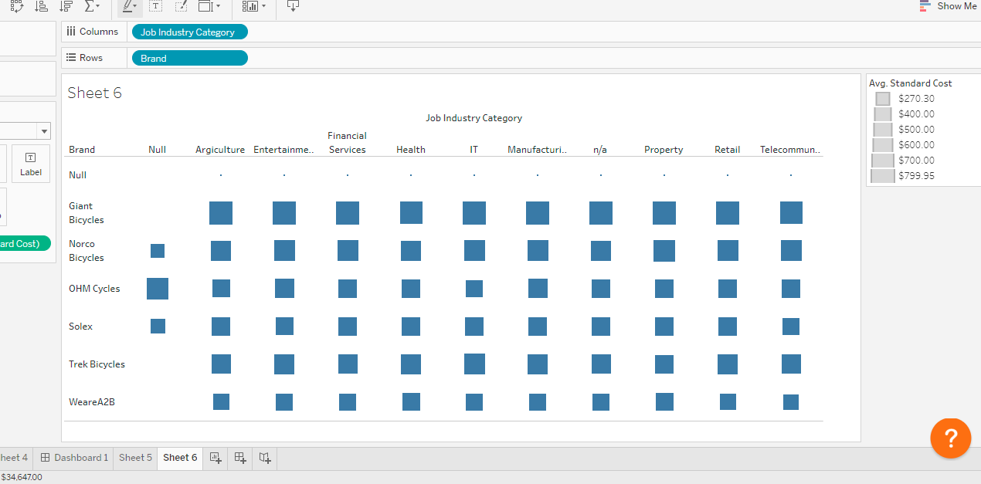
Data Interpretation :
Profit Distribution
Brand Distribution w.r.t Job Industry

